Slide 1
Introduction to Python

Slide 2
Session 3 - Agenda
What is Python?
Basic concepts in Python
OOP concepts in Python
Practical examples

Slide 3
What is Python?

Slide 4
What is Python?
Python is an interpreted, object-oriented, high-level programming language with dynamic semantics.
A very attractive solution for Rapid Application Development as well as a scripting language to connect existing components
Relatively simple, easy to learn. It focuses on readability.
Both the standard library and the interpreter are available free of charge.

Slide 5
Basic concepts in Python

Slide 6
Basic concepts in Python
Variables
What are variables?
Declaration
Initialization
Variables are containers for storing data values
You don’t need to declare variables before using them and you don’t need to declare their type
myint = 7
myfloat = 7.0
mystring = “Coolest string ever”
a, b = 3, 4

Slide 7
Basic concepts in Python
Data types in Python
int
float
bool
- used to store integers
- eg: myint = 3
- used to store floating point numbers
- eg: myfloat = 3.0
- two constant objects, True or False
- in the case of numbers, they behave like 0 and 1
- the build-in bool() function can be used to cast any value to a Boolean

Slide 8
Basic concepts in Python
Data types in Python
String
List
Dictionary
- a sequence of Unicode characters
- we can use single or double quotes to represent strings
- an ordered sequence of items
- can contain different types
- eg: mylist = [1, 3,14, “Cool string here”]
- an unordered collection of key-value pairs
- eg:
mydictionary = {1: ‘value’, ‘key’: 2}

Slide 9
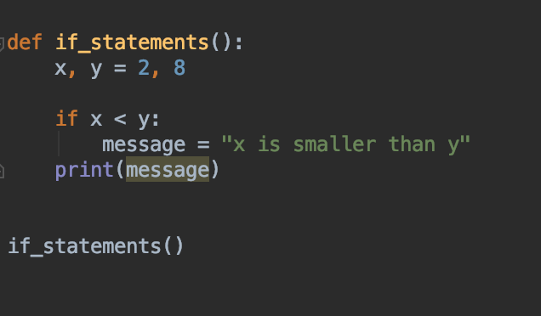
If statements
Simple if statement
It is used for decision making
It will run the body of the code only if the condition is true
The code on the right throws an error if x > y

Slide 10
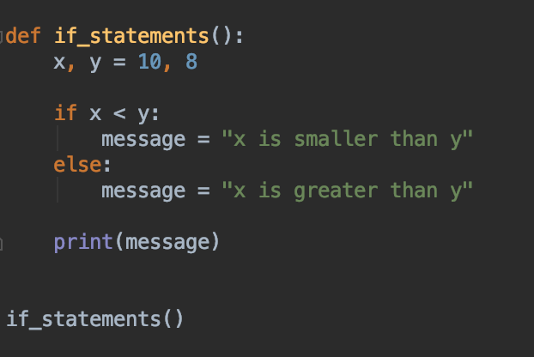
If statements
If else statement
The else condition is usually used when you want to judge one statement on the basis of another
The code on the right throws an error when x=y

Slide 11
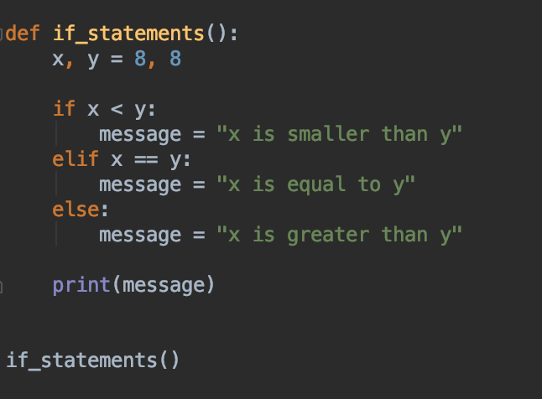
If statements
Elif statements
Elif acts like an if statement, if the initial statement failed

Slide 12
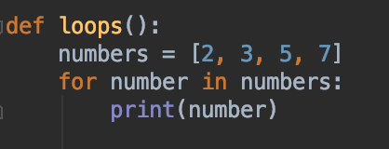
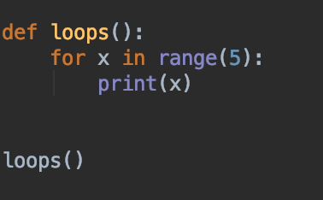
Loops
The for loop
The for loop is used to iterate over a given sequence
Similar to the for each construct in other programming languages
Can iterate over a sequence of numbers using the range function

Slide 13
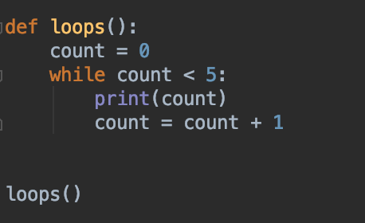
Loops
The while loop
Used to execute a block of code repeatedly, until a condition is met

Slide 14
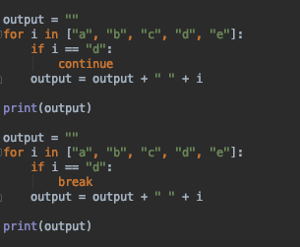
Loops
The continue and break keywords
Used for flow handling of a loop
continue is used for skipping the rest of the execution. When used, if the execution reaches the continue statement, it will move over to the next iteration of the loop
break is used for stopping the loop execution. When used, if the execution reaches the break statement it will stop the loop execution and move to the next statement after the loop

Slide 15
OOP concepts in Python

Slide 16
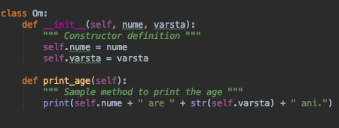
OOP Concepts in Python
Classes
Serve as a blueprint for objects
The keyword class is used to create a class in Python

Slide 17
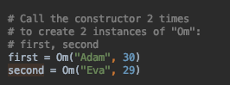
OOP Concepts in Python
Instances
An instance is a “realization” of a class
Creating an instance of a class is done by calling the constructor
When creating a new instance of a class the built-in method __init__ is called

Slide 18
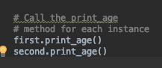
OOP Concepts in Python
Methods
Methods are called by their name, but they are associated to an object
A method can operate on the data(instance variables) that is contained in the corresponding class
Class methods have only one specific difference from ordinary functions - they must have an extra first name that has to be added to the beginning of the parameter list, you do not give a value for this parameter when, Python will provide it. This particular variable refers to the object itself, and by convention, it is given the name self

Slide 19
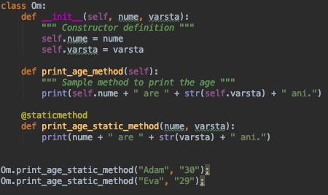
OOP Concepts in Python
Static Methods
Similar to class-level Python methods, the difference being that a static method is bound to a class rather than the object for that class
Can be called without an object for that class
They cannot modify the state of an object, as they are not bound to any object

Slide 20
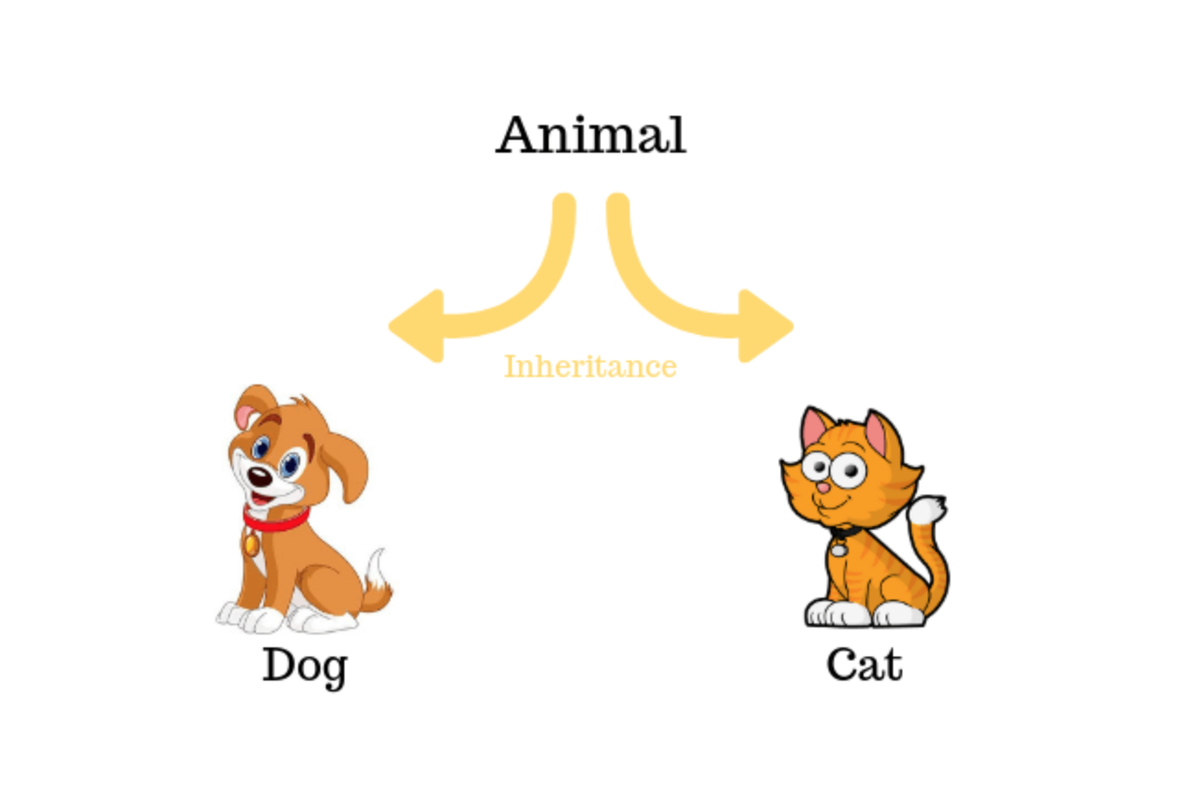
OOP Concepts in Python
Inheritance
The process by which one class acquires the properties and methods of another class is called inheritance
The Parent class is also called the base class
The Child class is also called the derived class

Slide 21
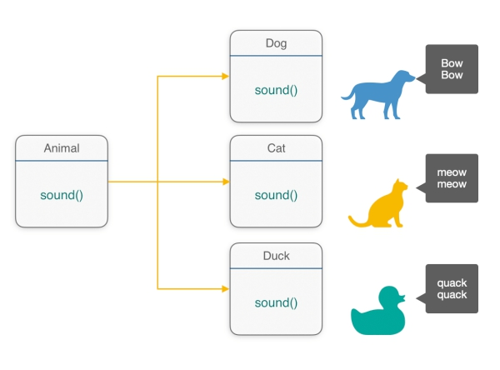
OOP Concepts in Python
Polymorphism
Polymorphism means many forms
It means the same function name being used for different types

Slide 23
Thank you!

